Slide 1

Account Segmentation
Methodology
2020

Slide 2


There are two main outputs from Segmentation –
Account Score and Account Potential
“Who should we pursue?”
“How much can they spend?”
“Who is most attractive?”
&
Account Score
Account Potential
Prioritized Accounts
PRIORITIZED
Propensity To Buy
Potential Spend Methodology
Account Score
DEPRIORITIZED
Account Potential

Slide 3
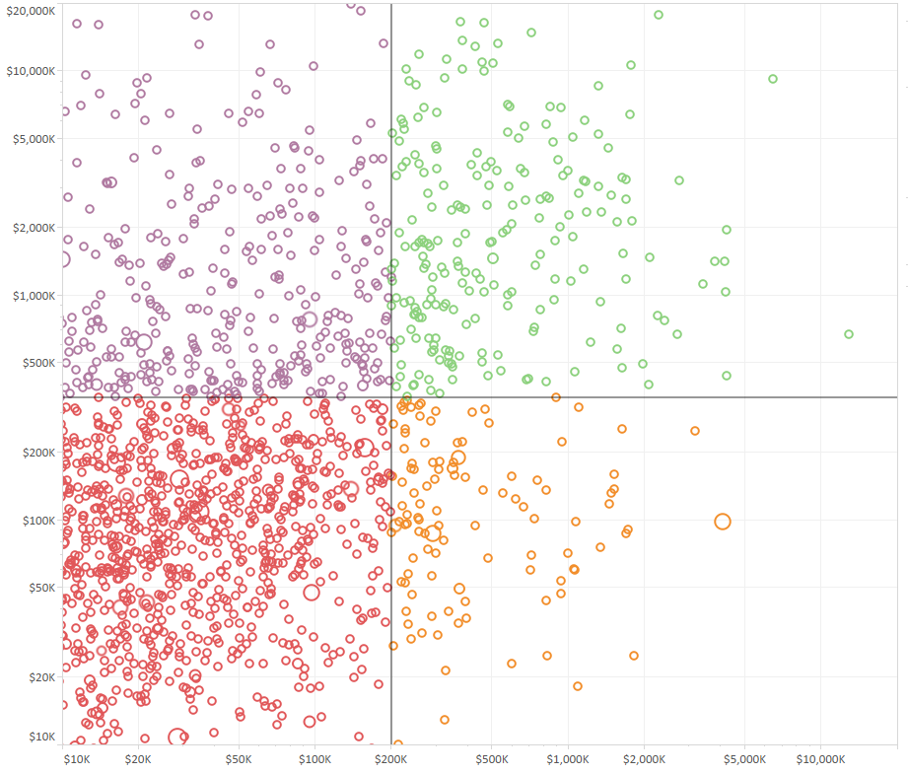
The ROAD Model (Retain, Opportunistic, Acquire, Develop) enables organizations to visualize market opportunity after Segmentation has been completed
Use Cases
Develop
Prioritization: Shown in its simplest form on the previous slide, the ROAD model is the output of account segmentation and is how you prioritize your accounts. Knowing which accounts have the highest potential value in relation to current spend enables organizations to develop tailored, targeted sales and marketing motions for each account.
Acquire
Potential Spend
Organization Design and Account Coverage: Aligning the right type of resources to the right type of account allows organizations to profitably capitalize on the potential value of each quadrant.
Opportunistic
Retain
Annual Recurring Revenue

Slide 4
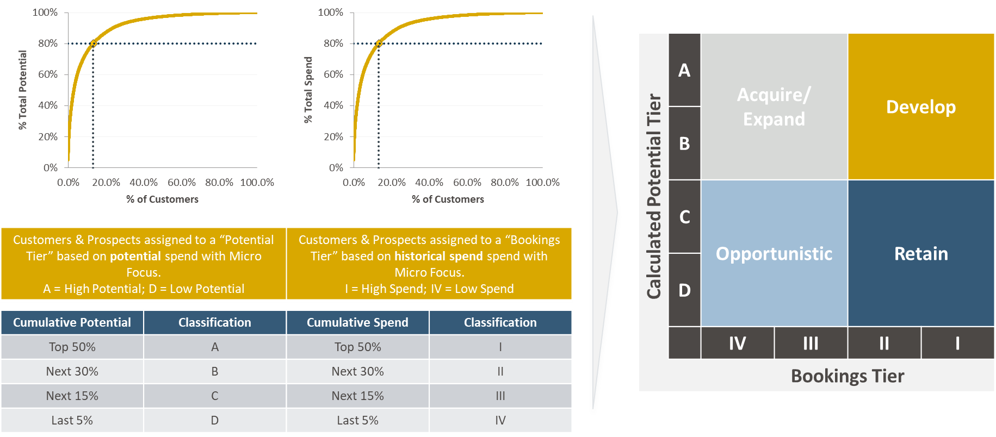
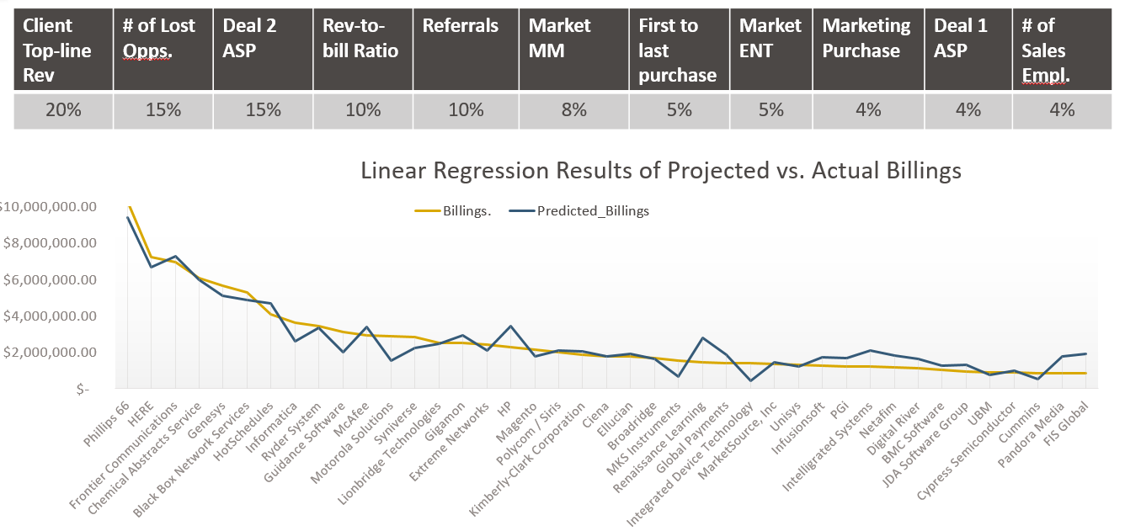
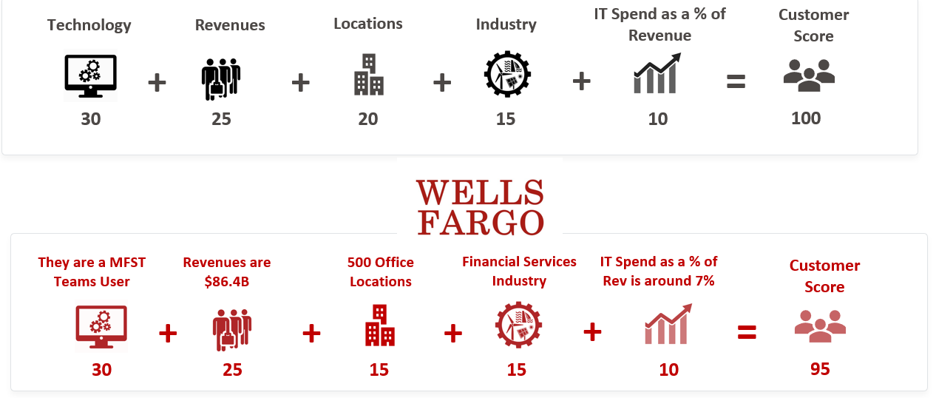
What does best-in-class Account Segmentation look like?
Overview
Approach
Properly align your sales & marketing resources to your highest value accounts.
Aligning sales and marketing efforts to your top accounts is the fastest way to produce growth. Having a deep understanding of your customer's ability to spend (and over what time frame) gives you a competitive advantage when making resource allocation decisions against market opportunities.
Data Collection and Management: Pull together all critical data points required to complete the exercise effectively
Calculate Potential Spend: Determine the frontier potential and apply to customers and prospects, to use as company’s potential spend
Analyze Current State: Conduct descriptive analysis and baseline current state to understand where revenue concentration is
Prioritize Accounts : Stack rank accounts based on both the Account score and Potential spend figures and begin prioritizing accounts with the highest scores
Define Account Score: Identify 4-6 firmographic factors and 1-2 nurture factors (data points you uncover after interacting with an account) that make up the Account Score
Example(s)
IMPACT
Win Rates
Average Deal Size
Productivity per Rep
Pipeline Generation
Average Sales Cycle Length
LTV:CAC Ratio

Slide 5

Account Segmentation follows a six-step process, starting with data collection
Data Collection
Data Cleansing
Data Enrichment
Data Analysis
Data Modeling (Segmentation Analysis)
Validation & Activation
Description:
Source and validate customer-level data Source and validate transaction-level data Source and validate prospect data | Clean and combine data in a BI tool or Excel Utilizing a BI tool will enable data and segmentation models to be more easily refreshed and expanded in the future | Utilize internal and 3rd party firmographic data to append key attributes to customer and prospect data Link enriched data back to cleansed customer and transaction data | Analyze preliminary data to see which factors are most relevant in determining an account's propensity to buy Conduct regression analysis on numerical data to develop Propensity-to-Buy factors in order to develop account score Define thresholds and key cohorts that need to be taken into consideration | Calculate potential within identified segments using frontier analysis Apply spend potential and account score to prospect and customer list Prioritize accounts and develop ROAD model | Validate output of model with GTM stakeholders Based on the output, develop guiding principles for how the sales org, coverage model, and territories will be refined Transition data model to ongoing owner and implement a semiannual update cadence
Data Collection | Data Cleansing | Data Enrichment | Data Analysis | Data Modeling | Validation & Activation

Slide 6
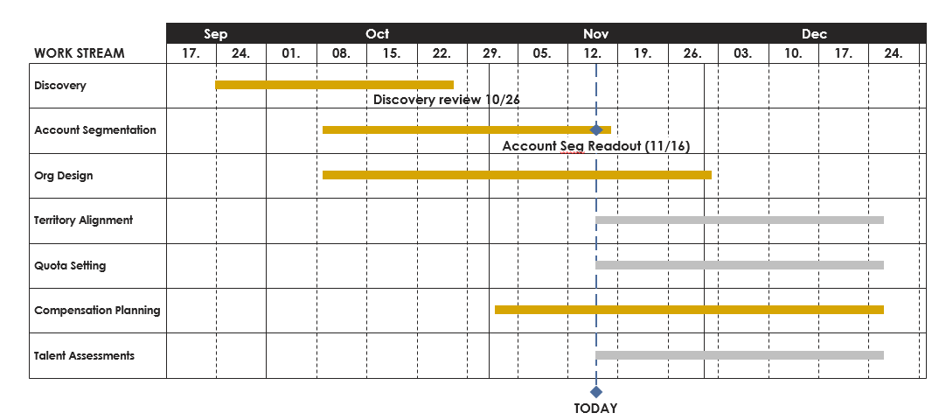
Define Timeline & Milestones:
Agree to what is going to be produced and by when
01
Key Activities
Main steps in defining timeline and milestones
01
Clearly define objective of account segmentation across all GTM functions
Set key dates and deliverable milestones
Discuss dependencies and implications
Identify required internal and 3rd party data sources for analysis
Set expectations on any more granular segmentation (i.e., product, industry, etc.)
02
03
04
05
Action Items
Define a timeline
01
Provide examples, lay out key milestones
Determine key dates, agree on granularity expectations
Understand and align on key timelines and milestones
Exit Criteria
02
All required data sources are identified, roles, responsibilities, milestones, and timelines are agreed upon across all stakeholders
03
Data Collection | Data Cleansing | Data Enrichment | Data Analysis | Data Modeling | Validation & Activation

Slide 7
Data Request:
Create and submit a data and documentation request
02
Key Activities
Main steps in data request
Data Requested | Owner / Source | Status | Notes
Master Customer List | Sales Ops |  | Received
Master Prospect List | Sales Ops |  | Received
Market Data | Strategy |  | TAM analysis in Progress
CRM Opportunity Extract | Sales |  | Awaiting updates from Sales Org
CRM Lead List | Sales |  | Awaiting updates from Sales Org
Marketing Activity Data | Marketing |  | Awaiting extract from Marketing
3rd Party Data | Data Lead |  | Identifying 3rd Party Data Providers
01
Complete the data and documentation request from internal and 3rd party sources
Utilize a tracking sheet to monitor status of data requests
Set clear timelines for when information needs to be returned
02
03
Sample data request tracking sheet
Action Items
Who is responsible for what
Assign a data lead (individual or team) that is responsible for:
Leading conversations on what data is required to complete account segmentation
Supporting and tracking the collection of data
Making decisions on any new data that may be required
Exit Criteria
Data requests have been submitted and status of requests are tracked to ensure all required data is received from internal or 3rd party sources
Data Collection | Data Cleansing | Data Enrichment | Data Analysis | Data Modeling | Validation & Activation

Slide 8
Receive All Data:
You have been provided all data
03
Key Activities
Main steps in receive all data
Data Requested | Owner / Source | Status | Notes
Master Customer List | Sales Ops |  | Received
Master Prospect List | Sales Ops |  | Received
Market Data | Strategy |  | Received
CRM Opportunity Extract | Sales |  | Received
CRM Lead List | Sales |  | Received
Marketing Activity Data | Marketing |  | Not received, will add to model when available
3rd Party Data | Data Lead |  | Data received from vendor
01
Monitor incoming data requests and review for initial validity
Update data request tracking sheet
Document data gaps and assumptions
Consolidate and cleanse data into usable formats
02
03
04
Sample data request tracking sheet
Action Items
Who is responsible for what
Assign a data lead (individual or team) that is responsible for:
Validating data quality and documenting gaps in data
Exit Criteria
You have collected the most important datasets -
customer data, prospect data, and information
from internal and 3rd party sources
Data Collection | Data Cleansing | Data Enrichment | Data Analysis | Data Modeling | Validation & Activation

Slide 9
Define, Analyze, and Validate Source Data:
Agree with internal team that the data being worked with is accurate
04
Main steps in validate data and define source data
 |  | Unit Numbers | De-Duped Unit Numbers | Total Records Contributed
SBI_Customers.xlsx | Customers | 227,025 | 185,781 | 185,781
UnisonActives.xlsx | Customers | 529,838 | - | 144
SBI_OrderInfo.txt | Customers | 194,213 | 194,213 | 8,432
Identified_Prospects.xlsx* | Prospects | N/A | N/A | 79,572
TOTAL |  |  |  | 273,929
Key Activities
01
Confirm understanding of data with data owners by conducting ‘basic’ analysis on customer set (i.e., # of customers, ASP, # of products per customer, etc.)
Formally agree to the key data set(s) to be used as the ‘source of truth’ (i.e., customer data, financial data, prospect data, etc.)
Begin building out model using source data as starting point
02
“Customer”
HR Block
03
Location Unit #
Location Unit #
HR Block
– Dallas Branch
HR Block
– Seattle Branch
ShipTo: Bill
DUNS
Number
ShipTo: Susan
ShipTo: Wilma
ShipTo: John
Action Items
Who is responsible for what
ShipTo: Alice
ShipTo: Gus
“Buyer”
“Buyer”
Assign a data lead (individual or team) that is responsible for:
Creating an agreed upon master data file that will be the foundation of the account segmentation initiative
Exit Criteria
Team has agreed to ‘source of truth’ data sets that will be the foundation of the account segmentation initiative
Data Collection | Data Cleansing | Data Enrichment | Data Analysis | Data Modeling | Validation & Activation

Slide 10
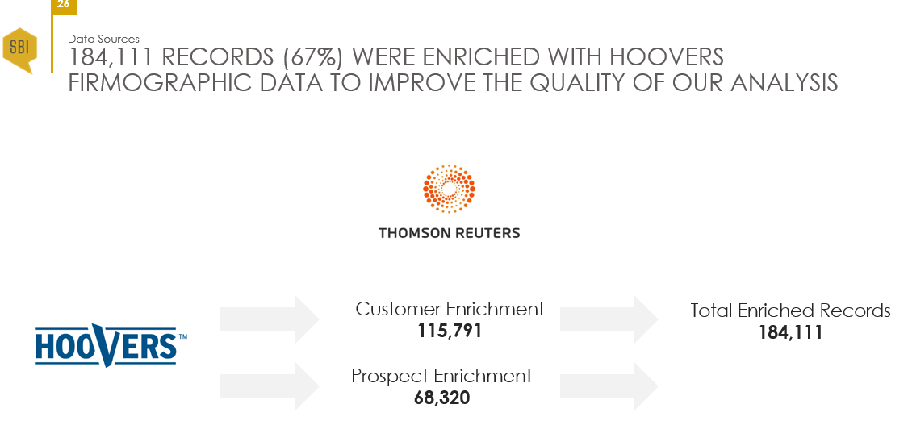
Create Model and Enrich Dataset:
Begin building the model and enrich the customer data with firmographic information
05
Key Activities
Main steps in create model and enrich data set
01
Set up main data tables (e.g. raw customer data, bookings information) from which all analyses will be executed
Append firmographic information to customer data (and prospect data if available) using third party data sources (e.g. Hoovers). Agree on what data will be appended
Main components of model: raw data, customer master, prospect list, assumptions, firmographic data, etc.
02
03
3rd Party Data Source
Action Items
Who is responsible for what
01
Team member creates model and enriches data
Assign member who oversees model build
Assign team that reviews and validates model periodically (preferably biweekly)
Identify team that reviews data set after information has been enriched for understanding
Exit Criteria
02
03
Company has built base model and all customer
data has been enriched with firmographic
information
04
Data Collection | Data Cleansing | Data Enrichment | Data Analysis | Data Modeling | Validation & Activation

Slide 11
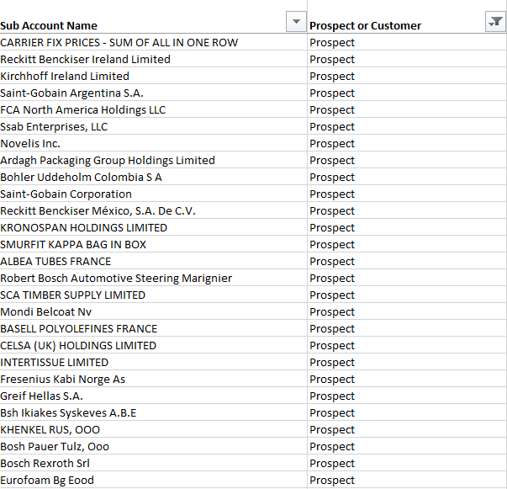
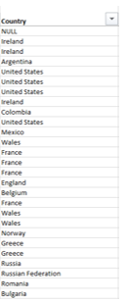
Add Prospects:
Incorporate prospects into the model
06
Key Activities
Add prospects
Note – monitor this action and when data is received
01
Agree to criteria that is used to build prospect data set (i.e., industries, geos, company sizes, etc.)
Pull prospect data from third party data
Incorporate into model and validate
Ensure no duplicate records with customers or prospects
02
03
04
Action Items
Who is responsible for what
01
Assign team member to pull prospects, adds into model
Team member provides input on prospect data and validates information
Sales Managers – provide input on prospect information
Assign someone who oversees step
Exit Criteria
02
03
Team has incorporated all prospects into the model and validated this with necessary stakeholders
04
Data Collection | Data Cleansing | Data Enrichment | Data Analysis | Data Modeling | Validation & Activation

Slide 12
Calculate Potential Spend:
Determine how much customers and prospects can spend in a given year
07
Prospect Equation
Company Revenue
% Translation Spend
Vertical Multiplier
Non Acme Solutions 97.8%*
Potential Revenue
Key Activities
Calculate potential spend
01
Agree to methodology for calculating potential spend and determine if difference exists between customers and prospects
Have defined ways to validate potential spend after calculating (i.e. sales leader validation)
Once calculated and agreed upon, “overlay” potential spend onto all accounts
Ensure methodology is dynamic
$66B
0.015%
0.82x
97.8%*
$7.99M
02
03
Customer (Upsell) Equation
Company Revenue (Hoovers)
% Translation Spend
Vertical Multiplier (CSA)
Previous Spend
Potential Upsell Revenue
04
$8 B
0.03%
0.61x
$664k
$813k
Action Items
Who is responsible for what
01
Assign team member who calculates potential spend
Assign team to QA approach and output
SME validates approach and output
Sales Leader / Managers – validate output
Exit Criteria
02
03
Stakeholders have agreed on output of potential spend and all accounts have a potential spend
figure associated with them
04
Data Collection | Data Cleansing | Data Enrichment | Data Analysis | Data Modeling | Validation & Activation

Slide 13
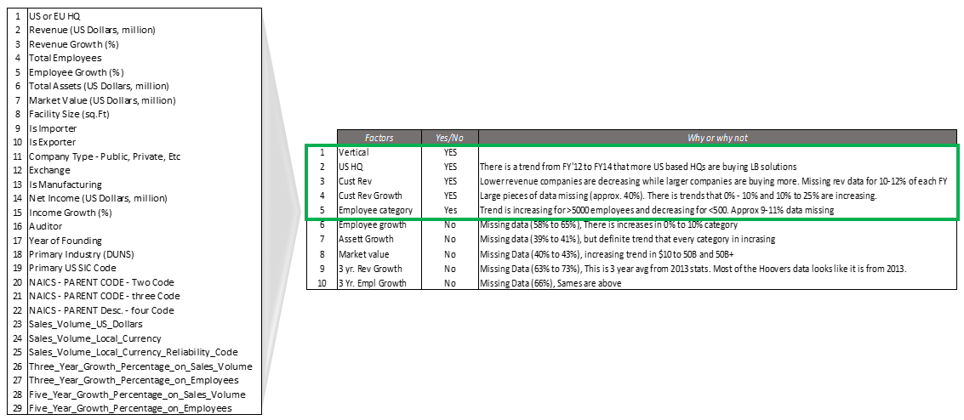
Define Propensity-to-Buy (PtB) Factors:
Determine the firmographic inputs that are used in the Account Score
08
Key Activities
Define propensity-to-buy (PtB) factors
01
Educate company how PtB factors are inputs to the Account Score.
Conduct Expert Panel with the sales org to get their input on what factors are most important and potential weighting. This should happen in first week(s) of project
Analyze various data factors for what is most predictive of what makes an “ideal” account
Determine if different PtB factors are needed for customers vs. prospects
Select PtB factors that are firmographic; avoid nurture factors if possible
02
03
04
05
Action Items
Who is responsible for what
01
Assign member who analyzes data for PtB factors; manages data build
Determine team who QAs approach and supports Expert Panel
Assign team member who runs expert panel; guides analyst on specifics
Tenured sales reps and managers – participate in Expert Panel
Exit Criteria
02
03
Company has agreed with the set of factors to be
used in the Account Score and the weighting of
each factor
04
Data Collection | Data Cleansing | Data Enrichment | Data Analysis | Data Modeling | Validation & Activation

Slide 14
Create the Account Score:
Take the PTB factors and translate those into an account score
09
Key Activities
Create the Account Score
Take the PtB factors from the prior step and incorporate that as a “formula” in the model
Overlay a “score” onto each account based on the PtB factors
Build the model so it is dynamic and can be augmented if the factors and/or weights change over time
Validate the output of the Account Score to ensure it’s accurate. For example, review the top customers and see what their scores are (should be near 100).
Company Rev.
Employee Size
Company Growth %
HQ
Total
01
+
+
+
=
02
03
40 pts.
35 pts.
15 pts.
10 pts.
100 pts.
+
+
+
=
04
Total company revenue
Total employee headcount
in company
Company revenue growth over
3 years
HQ location of
the company
Action Items
Who is responsible for what
01
Assign someone to build the account score formula into the workbook and to run the analysis
Exit Criteria
02
Identify team to QA approach and output
Assign team member who validates output of account scores
All accounts have an ‘Account Score’ assigned to
them and these are validated by key stakeholders
03
04
Expert panel– validate output of accounts scores
Data Collection | Data Cleansing | Data Enrichment | Data Analysis | Data Modeling | Validation & Activation

Slide 15
Stratify Your Accounts into a Retain, Opportunity, Acquire or Develop (ROAD) Model:
Determine what actions you need to take with each of your accounts
10
Key Activities
Stratify Accounts into ROAD Model
01
Determine ROAD model threshold and break points
02
Test and validate the threshold criteria with example accounts; tweak as needed
03
Model accounts into each threshold category – Retain, Opportunity, Acquire or Develop – based on their potential spend and propensity-to-buy
04
Prepare for validation
Action Items
Who is responsible for what
Exit Criteria
01
Assign team member who calculates potential
Stakeholders have agreed with potential and bookings thresholds and have agreed with the placement of customers and opportunities on
the ROAD grid
02
Assign team to QA approach and output
03
SME validates approach and output
04
Expert panel– validate output
Data Collection | Data Cleansing | Data Enrichment | Data Analysis | Data Modeling | Validation & Activation

Slide 16
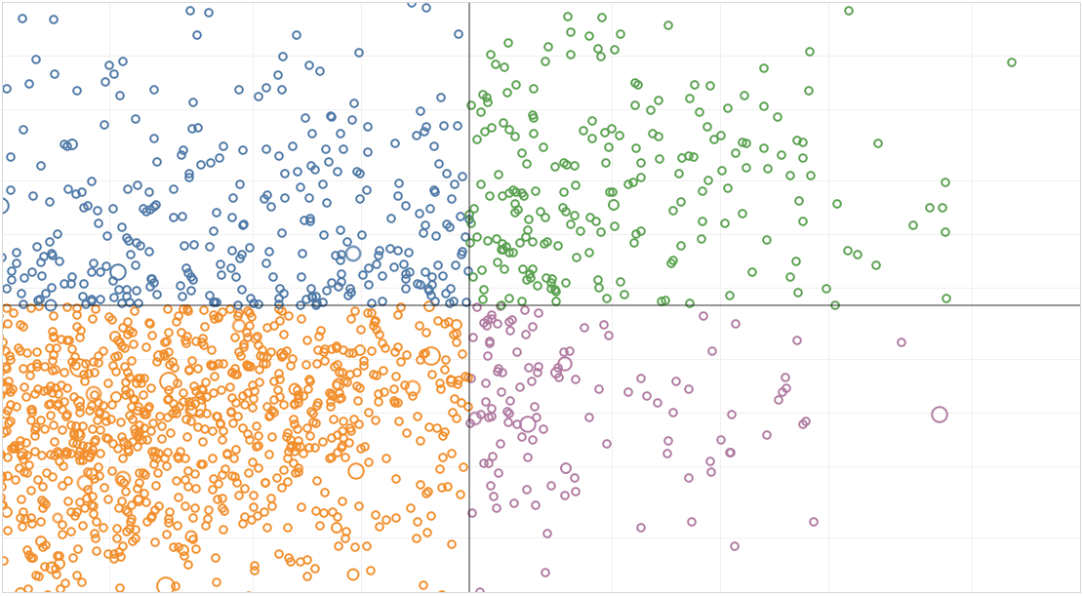
Validate Stack Rankings & Output:
Validate the final stack ranking of accounts and all data outputs
11
Prioritization Quadrant
Key Activities
Validate stack rankings & output
Stack rank the accounts based on Account Score and/or Potential Spend and review with stakeholders for final validation
Acquire
High Pursuit
01
Potential Spend
02
Make any final tweaks to potential spend and/or account score factors or weights at this time
Deprioritize
Opportunistic
03
Be ready to ‘celebrate’ this milestone so you can put a fork in the process that all the heavy analytical work has been completed
Account Score
Action Items
Who is responsible for what
Exit Criteria
01
Assign leader to run meeting to review the workbook and stack rank of accounts
You have validated the final output (Account Score and Account Potential) for all accounts
02
Assign team to support meeting
*At this time the modeling and ‘grunt work’ should be completed. There is no more need to go back and adjust potential spend and/or account score factors. This is critical so the model can now be used to derive the final set of insights and/or be “linked” to other company initiatives (e.g. Sales Org Design, Territory Design, ABM execution, etc.)
03
Stakeholders – agree that the output of the work is correct
Data Collection | Data Cleansing | Data Enrichment | Data Analysis | Data Modeling | Validation & Activation

Slide 17
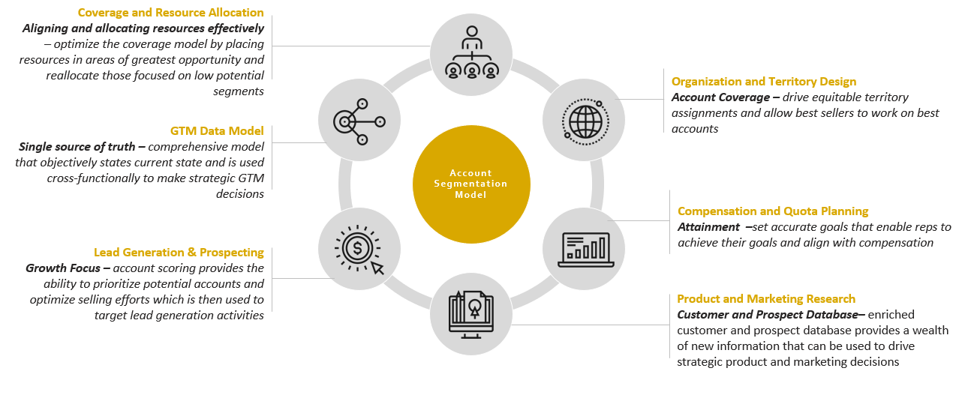
Develop Guiding Principles for How Your GTM Organization, Coverage Model, and Territory Design Should be Refined Based on the Output of the Account Segmentation Initiative
12
Key Activities
Produce insights and/or link to additional work
01
Identify guiding principles based on the account segmentation work (e.g., target more accounts in the enterprise segment)
02
Update GTM leaders on the main insights and guiding principles that came from the account segmentation initiative
03
Support changes to your organization, coverage model, or territory design with data and insights from the account segmentation initiative
Action Items
Who is responsible for what
Exit Criteria
01
Sales Operations leads meeting with GTM leadership to review findings from account segmentation initiative
Account Segmentation has been completed and recommendations for how to refine the sales organization, coverage model, and territory design has been communicated to GTM leadership
02
Data Lead supports Sales Operations during segmentation review meeting
03
Other GTM stakeholders review account segmentation outputs and provide input on how to take action to refine the GTM organization
Data Collection | Data Cleansing | Data Enrichment | Data Analysis | Data Modeling | Validation & Activation

Slide 18
Determine Who Will Own the Data Model Going Forward and Ensure Model Refinement Occurs Semiannually or With Major Org Changes
13
Account Segmentation: Ongoing Maintenance Responsibilities
Key Activities
Turnover model
 | Data Updates | Model Validation | Model Updates | Strategy Deployment
Sales Ops | A/R | A/R | A/R | C
Sales | I | I | I | A/R
Marketing | I | I | I | A/R
Finance | C | C | C | C
IT | C | C | C | C
01
Determine who will own the model ongoing
02
Create a ‘guide’ that captures all the key points of the model, how to use it and what assumptions are included
03
Transition model to owner and implement an ongoing maintenance/update cadence
Action Items
Who is responsible for what
Exit Criteria
01
Data Lead prepares all material to turnover to future owner and runs turnover meeting
with identified individual
Account segmentation model has been successfully turned over to future owner and an ongoing maintenance & update cadence has been put in place
02
GTM leadership and other stakeholders ensure the output of the segmentation initiative is utilized and maintained on a semiannual basis
Data Collection | Data Cleansing | Data Enrichment | Data Analysis | Data Modeling | Validation & Activation

