Slide 1

Sales Enablement Approach
Approach and Best Practice Examples

Slide 2
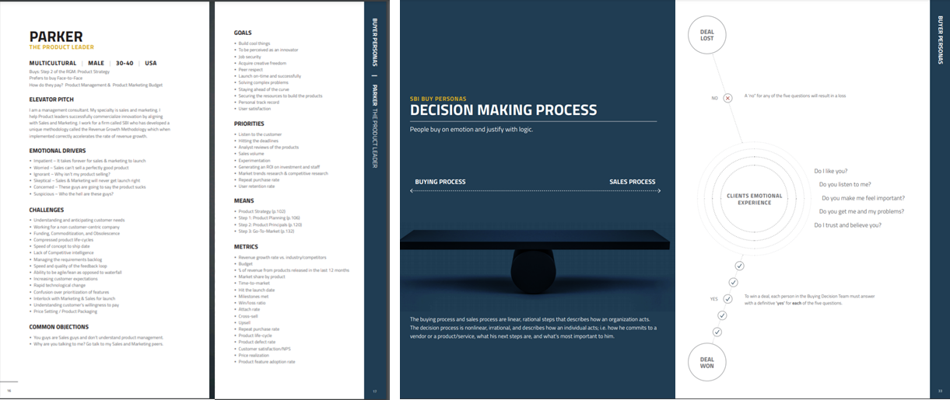
What does best-in-class Sales Enablement look like?
Overview
Arm reps with the resources to maximize revenue from new and existing clients
IMPACT
Aligning investment and training to the right resources that reps can continually leverage in their roles is critical to driving rep performance, onboarding new hires quickly and retaining A-player talent.
Example(s)
A company’s revenue goal needs to be supported by reps equipped to sell their solutions with support and ease. Unfortunately, this is rarely the case. Sales Enablement helps existing reps perform at their best and new reps upskill quickly to make their number.
Reps often miss their quota not because of a gap in talent, but because they lack the structural support required for them to succeed in the role.
Approach
Assess Current Talent to understand which current level of competency across the sales force and to understand individual enablement needs
Assess Current State of Enablement: determine enablement strengths and weakness;; analyze current state to understand contributing factors to rep performance and coaching
Develop Charter & KPIs based on sales environment, organizational structure and coaching culture
Construct & Launch Enablement to deliver actionable resources to reps in the field
Ongoing Refinement to build upon and continue to develop A-player talent and upskill reps to compete in your marketplace

Slide 3
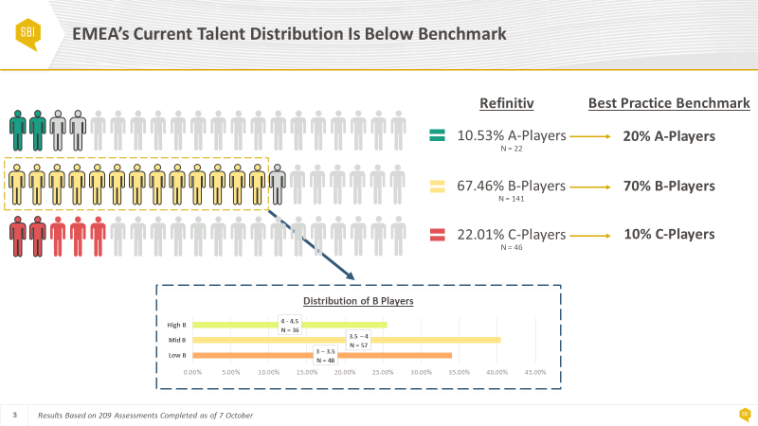
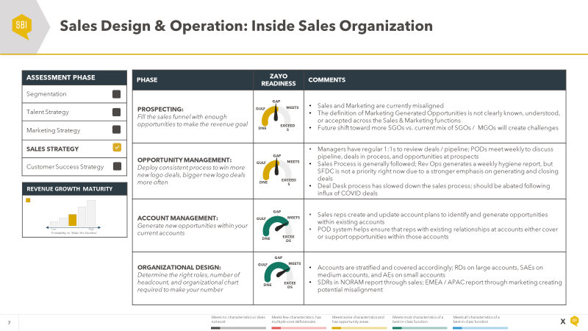
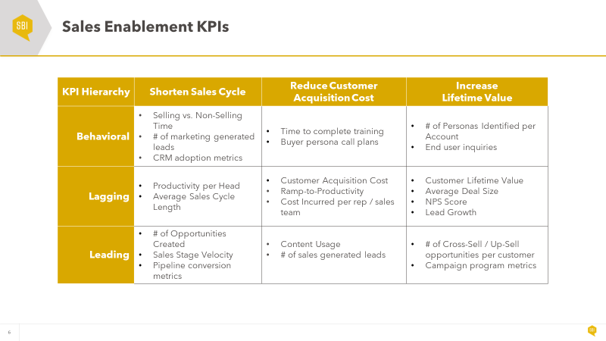
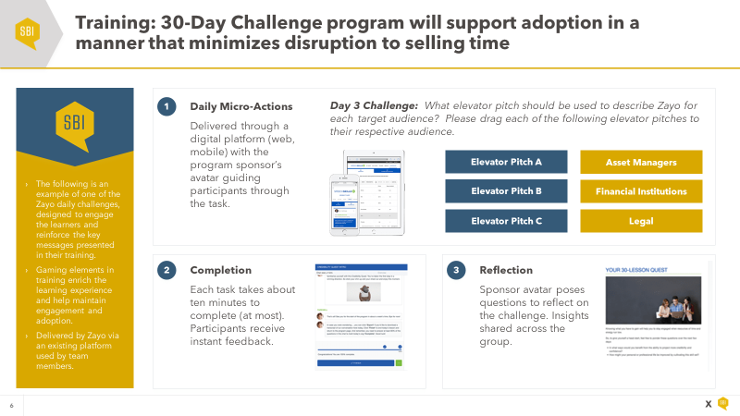
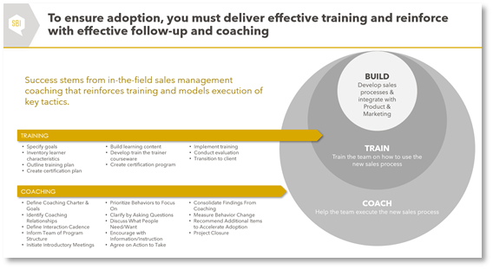
SBI’s 5-step Sales Enablement methodology begins with an assessment of talent across the sales organization
STEP 1:
Assess Current Talent
STEP 2:
Assess Enablement
STEP 3:
Develop Charter/KPIs
STEP 4:
Construct & Launch
STEP 5:
Ongoing Refinement
Description:
Description:
Description:
Description:
Description:
Align with client leadership on most essential competencies for success in selling roles
Assess all sellers against those competencies
Determine areas of greatest universal enablement needs while also developing a view on the greatest enablement needs by individual.
Review existing coaching, training, and enablement material and how often it is leveraged in the GTM organization
Interview field sellers to understand existing enablement and identify gaps
Define the mission, objectives, and desired outcome of sales enablement program
Align internal resources to prepare for training cadence, notifying trainers/coaches, and housing enablement content & resources
Leverage assessment findings and rep interviews to focus content on high-priority areas that will improve rep performance and efficiency
Rollout enablement content and certification program and communicate cadence to GTM leadership and field sales managers
Collect feedback on usage and adoption of enablement materials to refine focus over time as the market and solution offering evolve

Slide 4

Sales Enablement Components

Slide 5
World class Sales Enablement can be broken into 8 components, all beginning with a charter defining the program’s objectives
What does it mean to leverage Sales Enablement appropriately?
Sales Enablement gets the right sales content, in the hands of the right sellers, at the right time, to move a sales opportunity forward.
The use of Sales Enablement means increases in effectiveness, measured in sales revenue per employee and quota attainment.
Leveraging buyer personas & BPMs, playbook, and call plans to increase wallet share & penetration rates.
Sales Enablement Charter
Sales Content Guidance
Playbook Development
Sales Training
Certification
Coaching
Measurement
Technology Roadmap

Slide 6
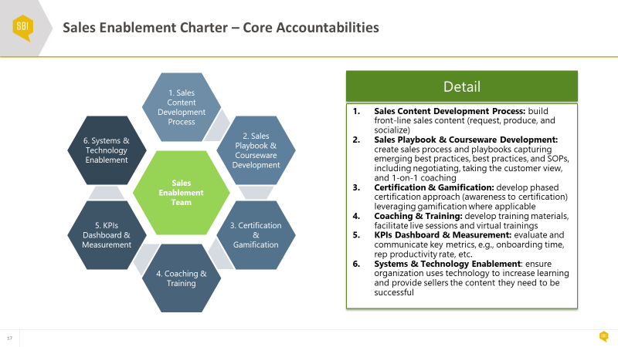
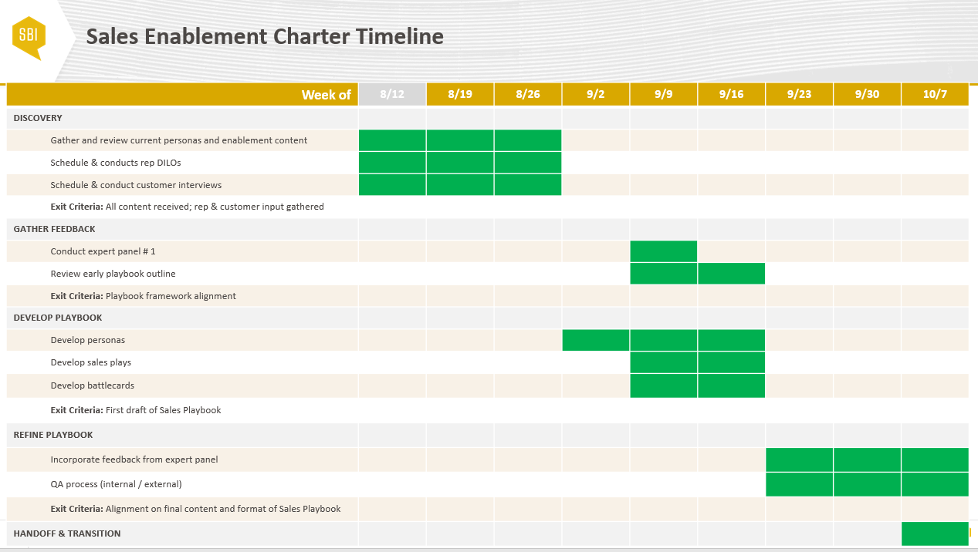
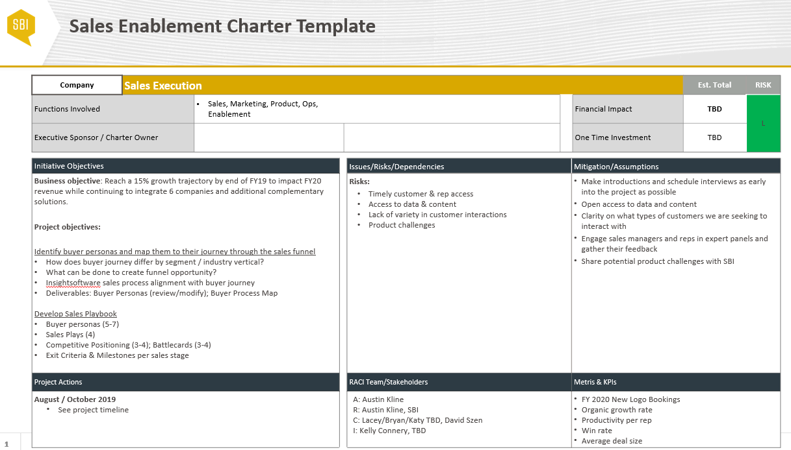
The Sales Enablement Charter defines the enablement program’s objectives and approach
Objective
Define the sales enablement approach that will get the right sales content into the hands of the right sellers at the right time to move a sales opportunity forward. The charter should guide the efforts of the enablement function overall while also creating clarity around who is responsible for what.
Outcomes & Typical Deliverables
Sales Enablement Mission, Vision and Values
Sales Enablement Goals (Activities/Results)
Sales Enablement Scope (Process Descriptions)
Playbook Development (New Product Introductions and SKU expansion)
KPIs, meeting cadences & structure, etc.
Sales Enablement Roles and Responsibilities
Sales Enablement RACI (Responsible, Accountable, Consulted, Informed)

Slide 7
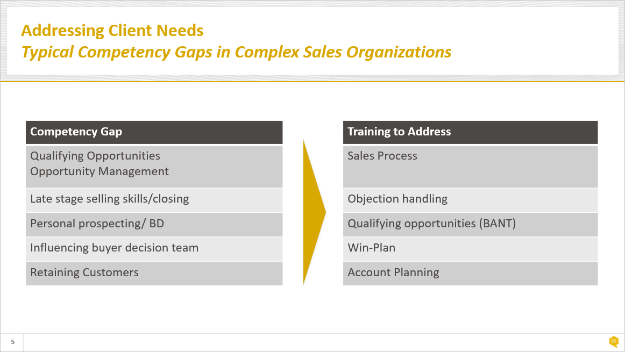
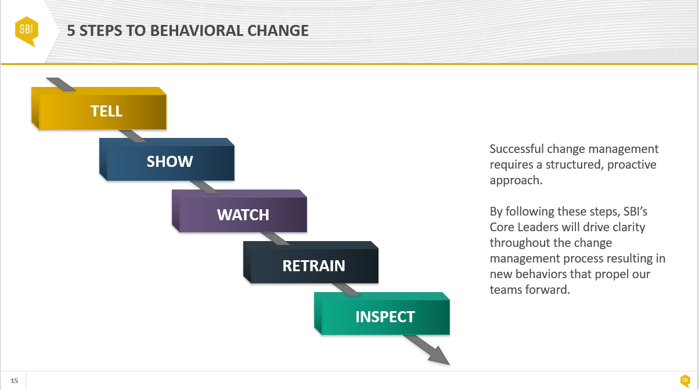
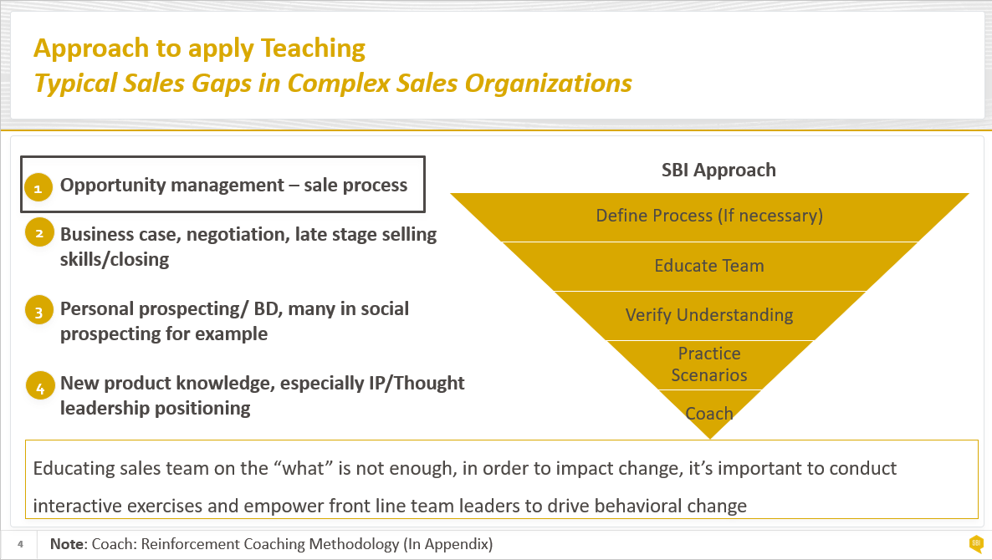
The Enablement function should be Sales’ voice helping to guide the sales content that Marketing creates
Objective
Serve as the voice of sales, so marketing can develop the sales content needed to increase wallet share, penetration rates, and/or land new accounts. Manage the content management system, and ensure that Marketing is helping to make sales more effective in ways other than lead generation. Ensure that there is continuing clarity on Marketing’s role in enabling the sales force and this role is clearly codified in the Sales Enablement charter.
Outcomes & Typical Deliverables
Content Assessment
Creation/Curation Process
    Ensure relevance with Personas and Buyer Process Maps
Content Lifecycle Management
Content Usage Tracking

Slide 8
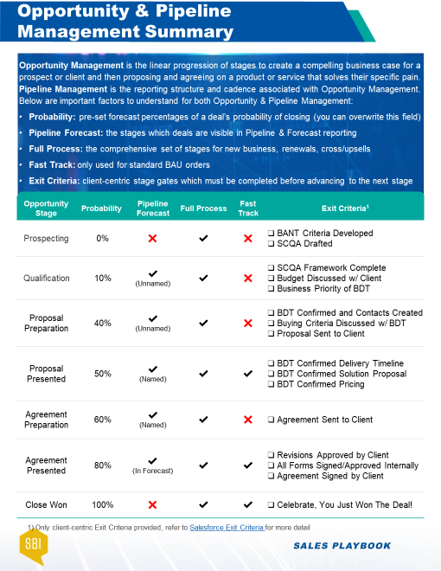
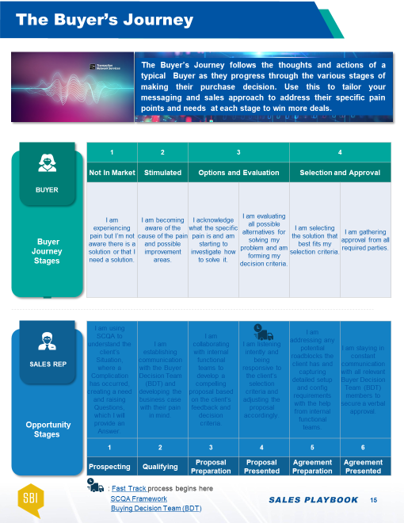
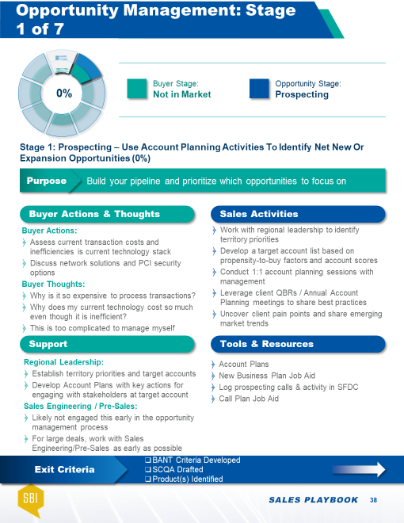
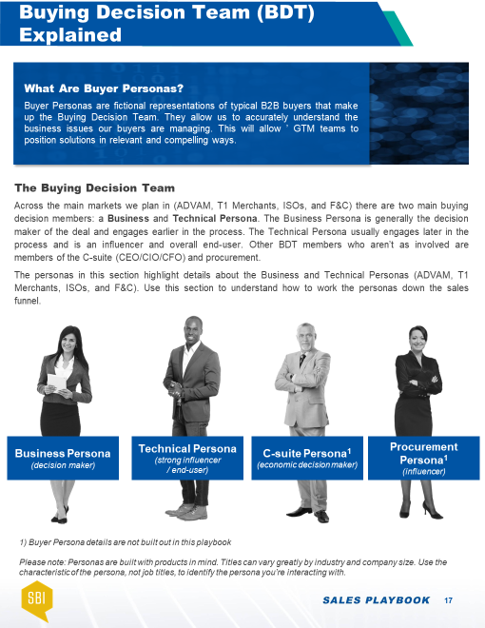

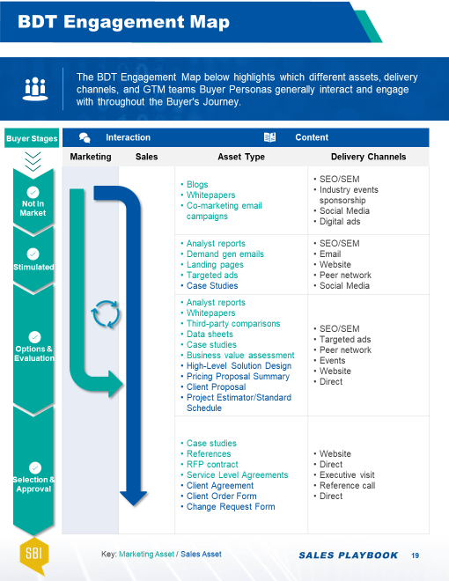
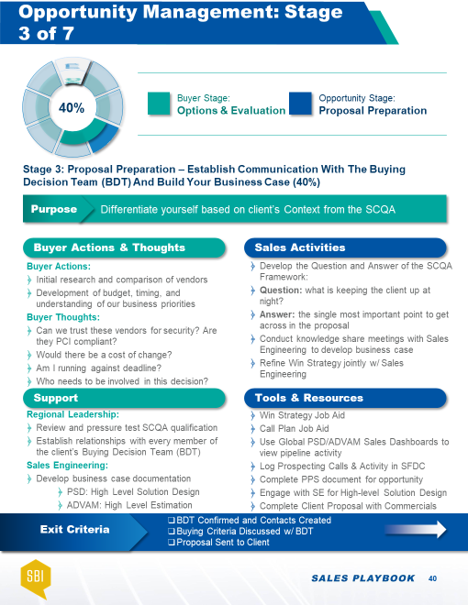

Enablement playbooks should map to a comprehensive sales process and methodology
Objective
Design, implement, and package playbooks that represent a single source of information to guide the day-to-day efforts of sellers and make them more effective. Playbooks should be built around a consistent sales process, and should include ‘plays’ that sales reps should run at different points within the process. Playbooks should drive greater understanding of buyer persona, buyers’ motivations, their decision-making process, and how to present value to different types of buyers.
Outcomes & Typical Deliverables
Playbook that encompass:
          Detailed guidance around a standardized sales process
          Sales Plays / Call/Visit Choreography
          Misc. Sales Aids (i.e. Objection Handling, Opportunity Assessments, etc.)
          Buyer Personas
          Buyer Process Maps
          Competitive Landscape & Battle Cards
Product Launch Planning/Product Use Scenarios/Product Demos
Pricing/discounting guidelines
Marketing Campaign Schedule

Slide 9
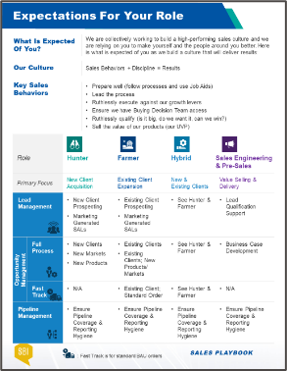
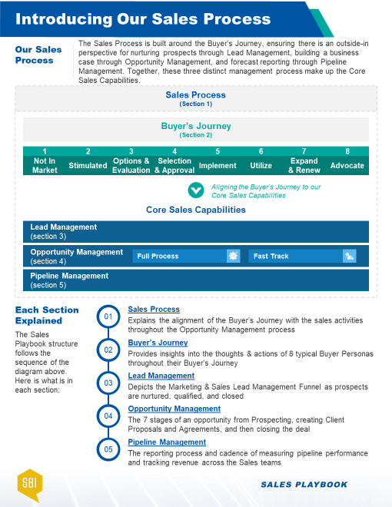
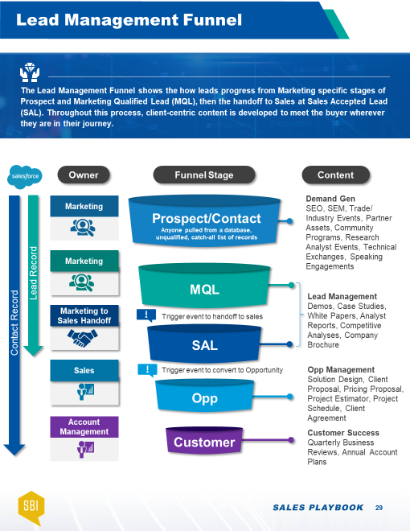
A strong onboarding & training program accelerates new hire ramp times and drives productivity gains throughout the employee lifecycle
Objective
Train the sales team on the sales skills and product knowledge needed to meet buyer needs. Create consistency in the way that training is delivered to both new and tenured reps. Drive training through different modalities – in-person, online, etc. Maximize the training value of events like Sales Kickoff (SKO).
Outcomes & Typical Deliverables
Courseware Development
Onboarding Planning, Design and Execution
Ongoing Training Planning, Design and Execution
Reinforcement Plan
Reinforcement Execution
Sales Skills Training
Translate Product training into applicable sales training
SKO and other internal events

Slide 10
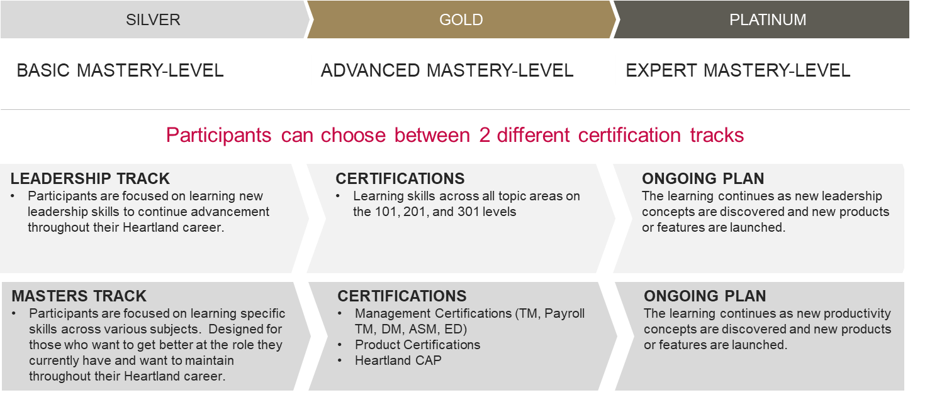
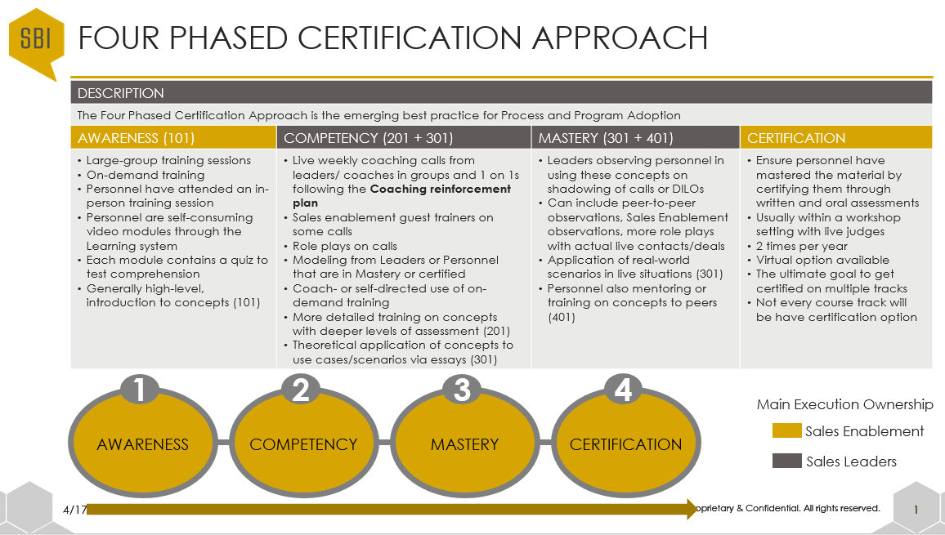
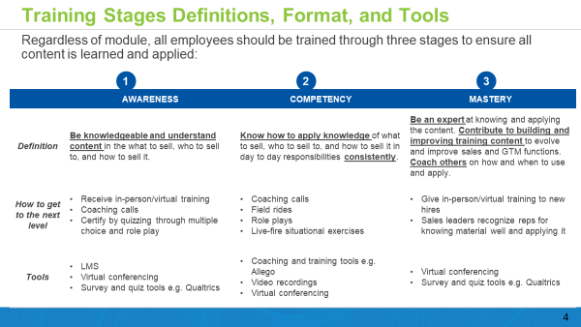
Certification programs drive accountability for sellers to advance from Awareness to Competency to Mastery of key concepts
Objective
Certify that sales training has been absorbed by the sales team. Ensure that sales enablement assets have been adopted by the sales team. Create a competitive environment where learning is encouraged and rewarded. Leverage gamification for learning, reinforcement, and motivation.
Outcomes & Typical Deliverables
Maintain Certification Process
Facilitate Certification Process
Recognition programs, contests, president’s club
Spiffs
Game Design (rules, points, prizes)
Real Time Leaderboard Design & Execution
Gamification Communication Plan
Gamification Administration

Slide 11
Sales coaching is essential to reinforcing learnings gleaned from the sales enablement program
Objective
Create a culture of sales coaching where Managers execute against defined expectations around coaching. Provide guidance and structure that enables Managers to be better coaches. Provide continuous training on how to maximize the value of coaching.
Outcomes & Typical Deliverables
Coaching charter
Sales team communication planning and execution
Coaching cadence
Coaching process & job aids
Coaching playbook
Individual Development Plans
Train-the-Trainer Session(s)
Coaching Certification
  Define Coaching Charter and Goals
  Identify Coaching Relationships
  Schedule Interaction Cadence
  Inform Team of Program Structure
  Initiate Introductory Meetings
Goal Setting
  Prioritize Behaviors to Focus On
  Clarify by Asking Questions
  Discuss What People Need/Want
  Encourage with Information/Instruction
  Agree on Action to Take
Coaching
  Consolidate Findings From Coaching
  Measure Behavior Change
  Performance Feedback
  Solicit Feedback to Accelerate Adoption
Feedback & Measure

Slide 12
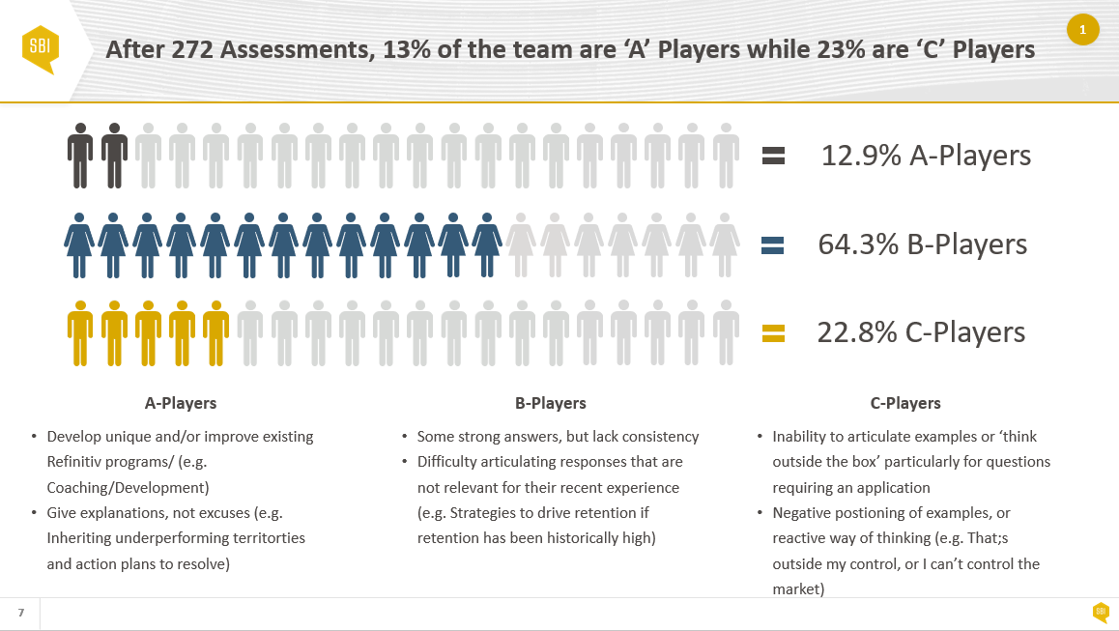
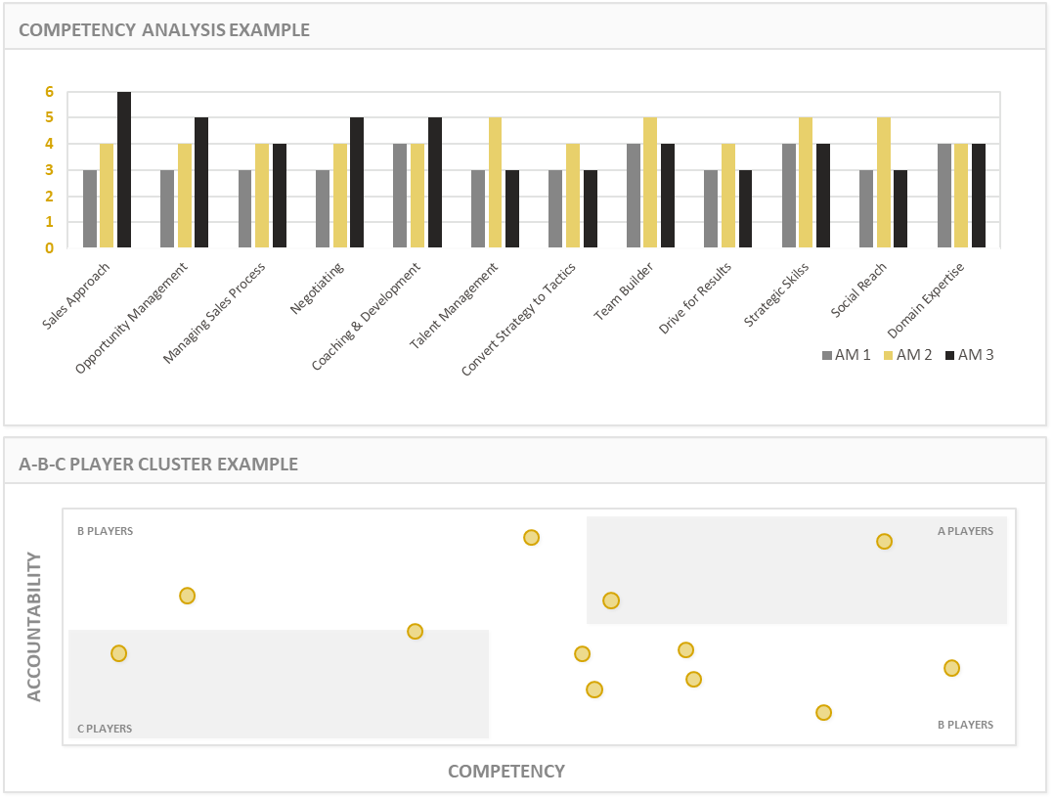
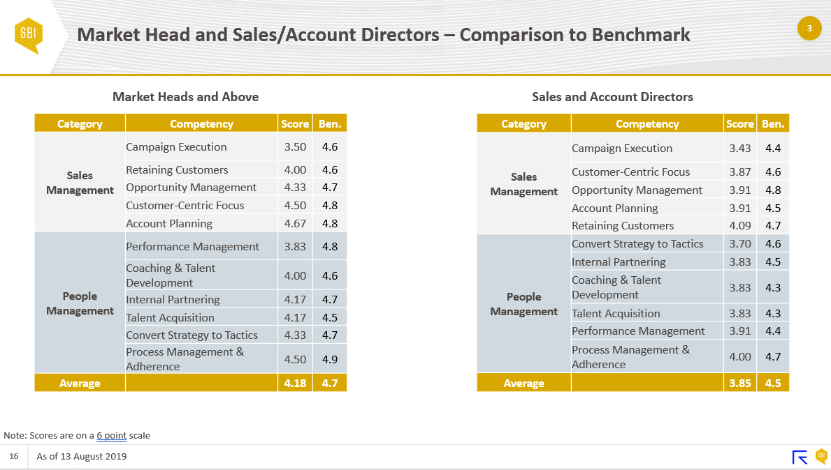

The impact of Enablement should be measured across Behavioral, Lagging, and Leading KPIs
Objective
Measure the impact of the investment in sales enablement. Identify the KPIs that define the effectiveness of sales enablement and create dashboards that will effectively track these KPIs.
Outcomes & Typical Deliverables
Defined measurable goals of Sales Enablement program
Partner with Sales Operations on appropriate metrics to track: Behavioral, Leading, Lagging
Partner with Sales Ops to develop dashboards to track progress – individual and aggregated

Slide 13
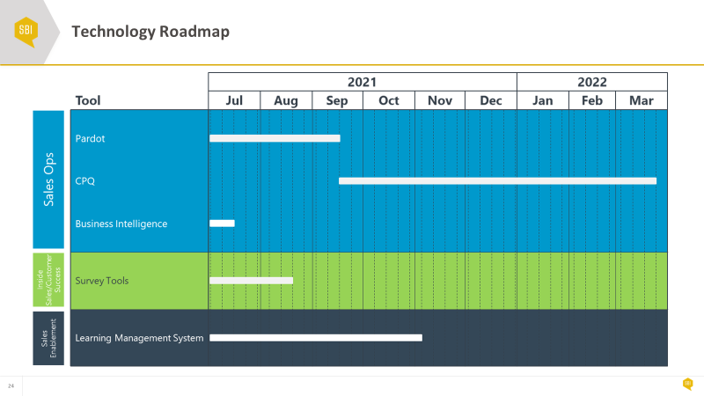
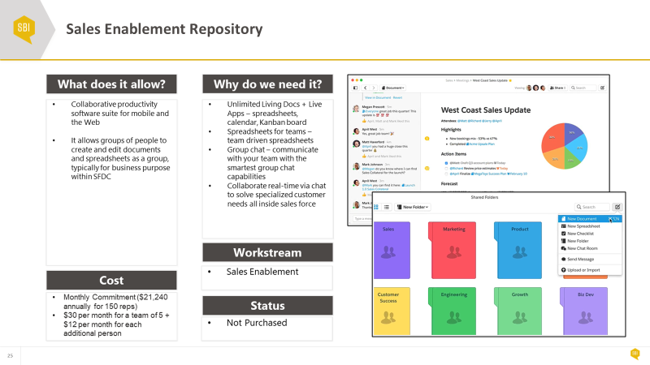
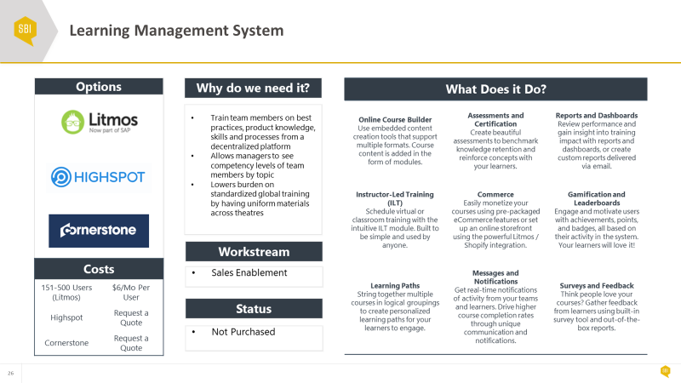
The long-term effectiveness of Sales Enablement largely hinges on the technology and tools that will support the program
Objective
Automate the core business processes to increase the productivity of the sales organization while reducing any administrative burden. Document business/functional requirements that will lead to greater sales productivity. Identify and implement technologies that will play a role in the future training & enablement of the sales force.
Outcomes & Typical Deliverables
Technology roadmap
CRM (Identify & Implement)
Content Management System
Learning Management System (LMS)
Knowledge Management System
Mobile functionality (including Automated Playbooks)
Gamification tools
Quality Assurance System (eg. call monitoring w/recording capabilities for inside sales)

Slide 14

Thank You

