Slide 1
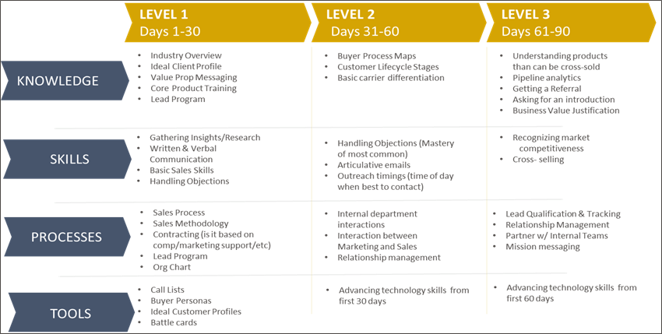
An optimized on-boarding process can put your investment to work quicker and save on opportunities costs from lack of productivity

